Slide 1
Neural Rendering for Robotic Locomotion
Aritra Ray
End-term Project Presentation
ME555: Robot Learning, Fall 2022

Slide 2
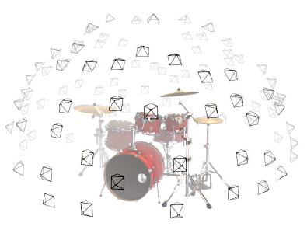
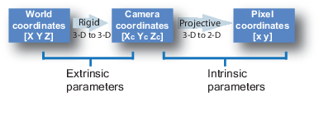
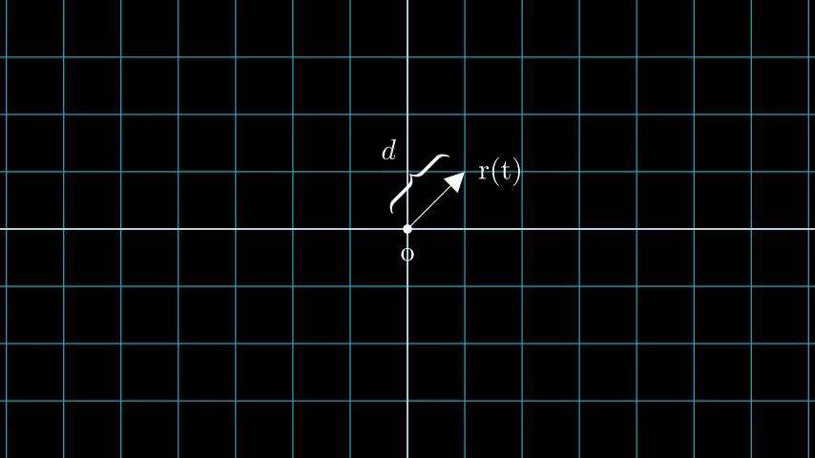
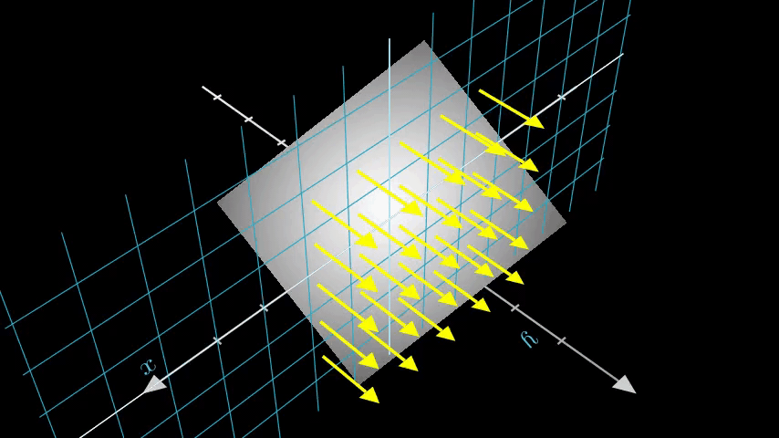
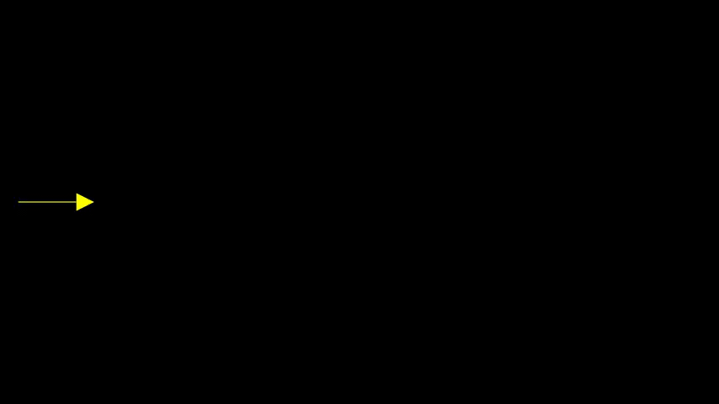
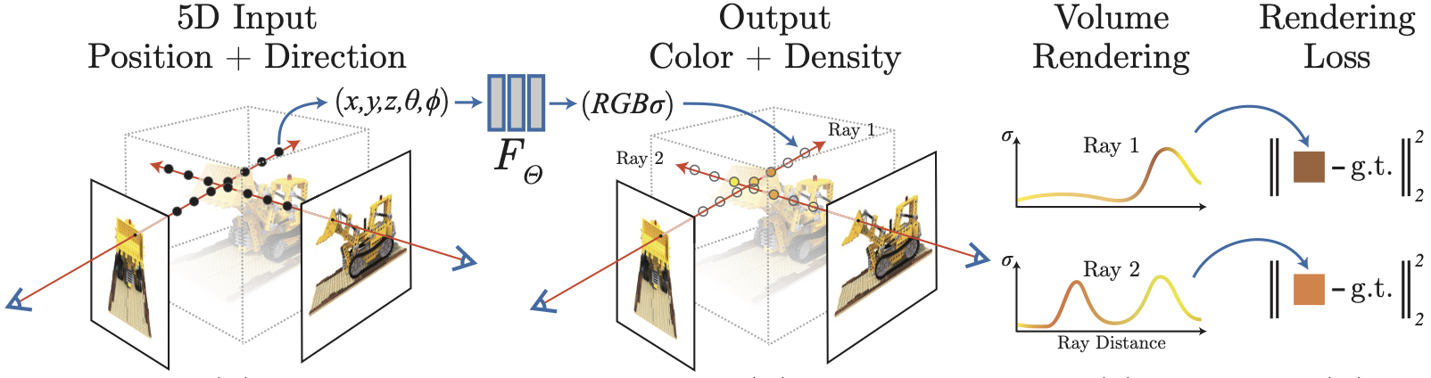
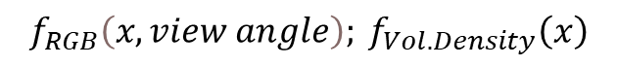
Recap NeRF
Can we do Inverse Mapping? from a 2D image to the 3D scene
NeRF MLP
$$f_{RGB}\left(x, view angle\right); f_{Vol. Density}\left(x\right)$$
Input: Sampled points
Output: Predict the RGB color, and volume density at that point
r(t) = o + td
Output: For every point –
View-Dependent RGB color
View-independent volume density

Slide 3


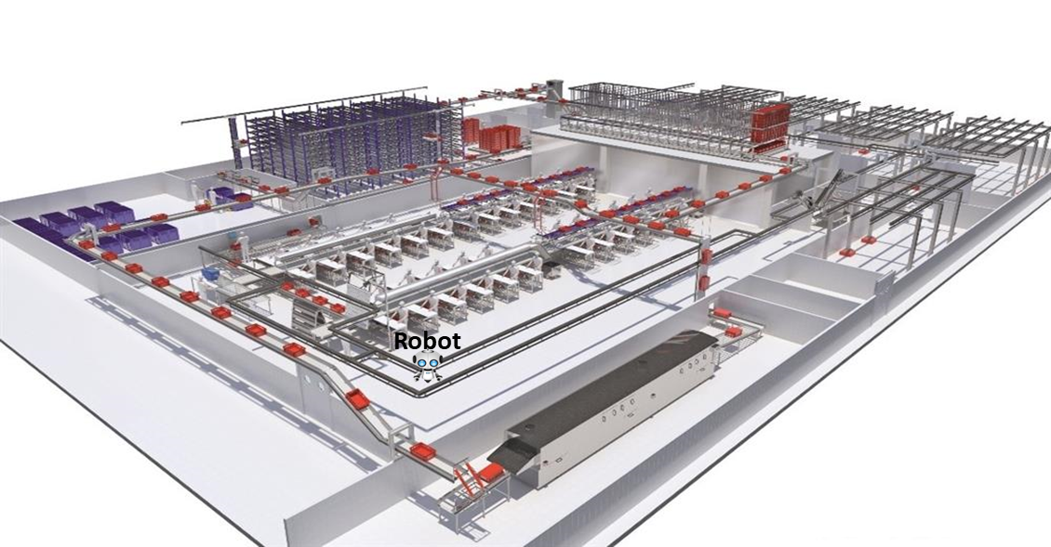

Proposed Architecture
Send video to cloud for neural rendering
Cloud
Capture Video of the immediate environment
Rendered Novel Scenes

Slide 4

Predicted Video Frames
Video Similarity
Send video to cloud for neural rendering
Offline Optimized NeRF Training
Predict Next In-sequence Video Frames
Capture Video of the immediate environment
Below Threshold
Online Optimized NeRF Training
Rendered Novel Scenes

Slide 5
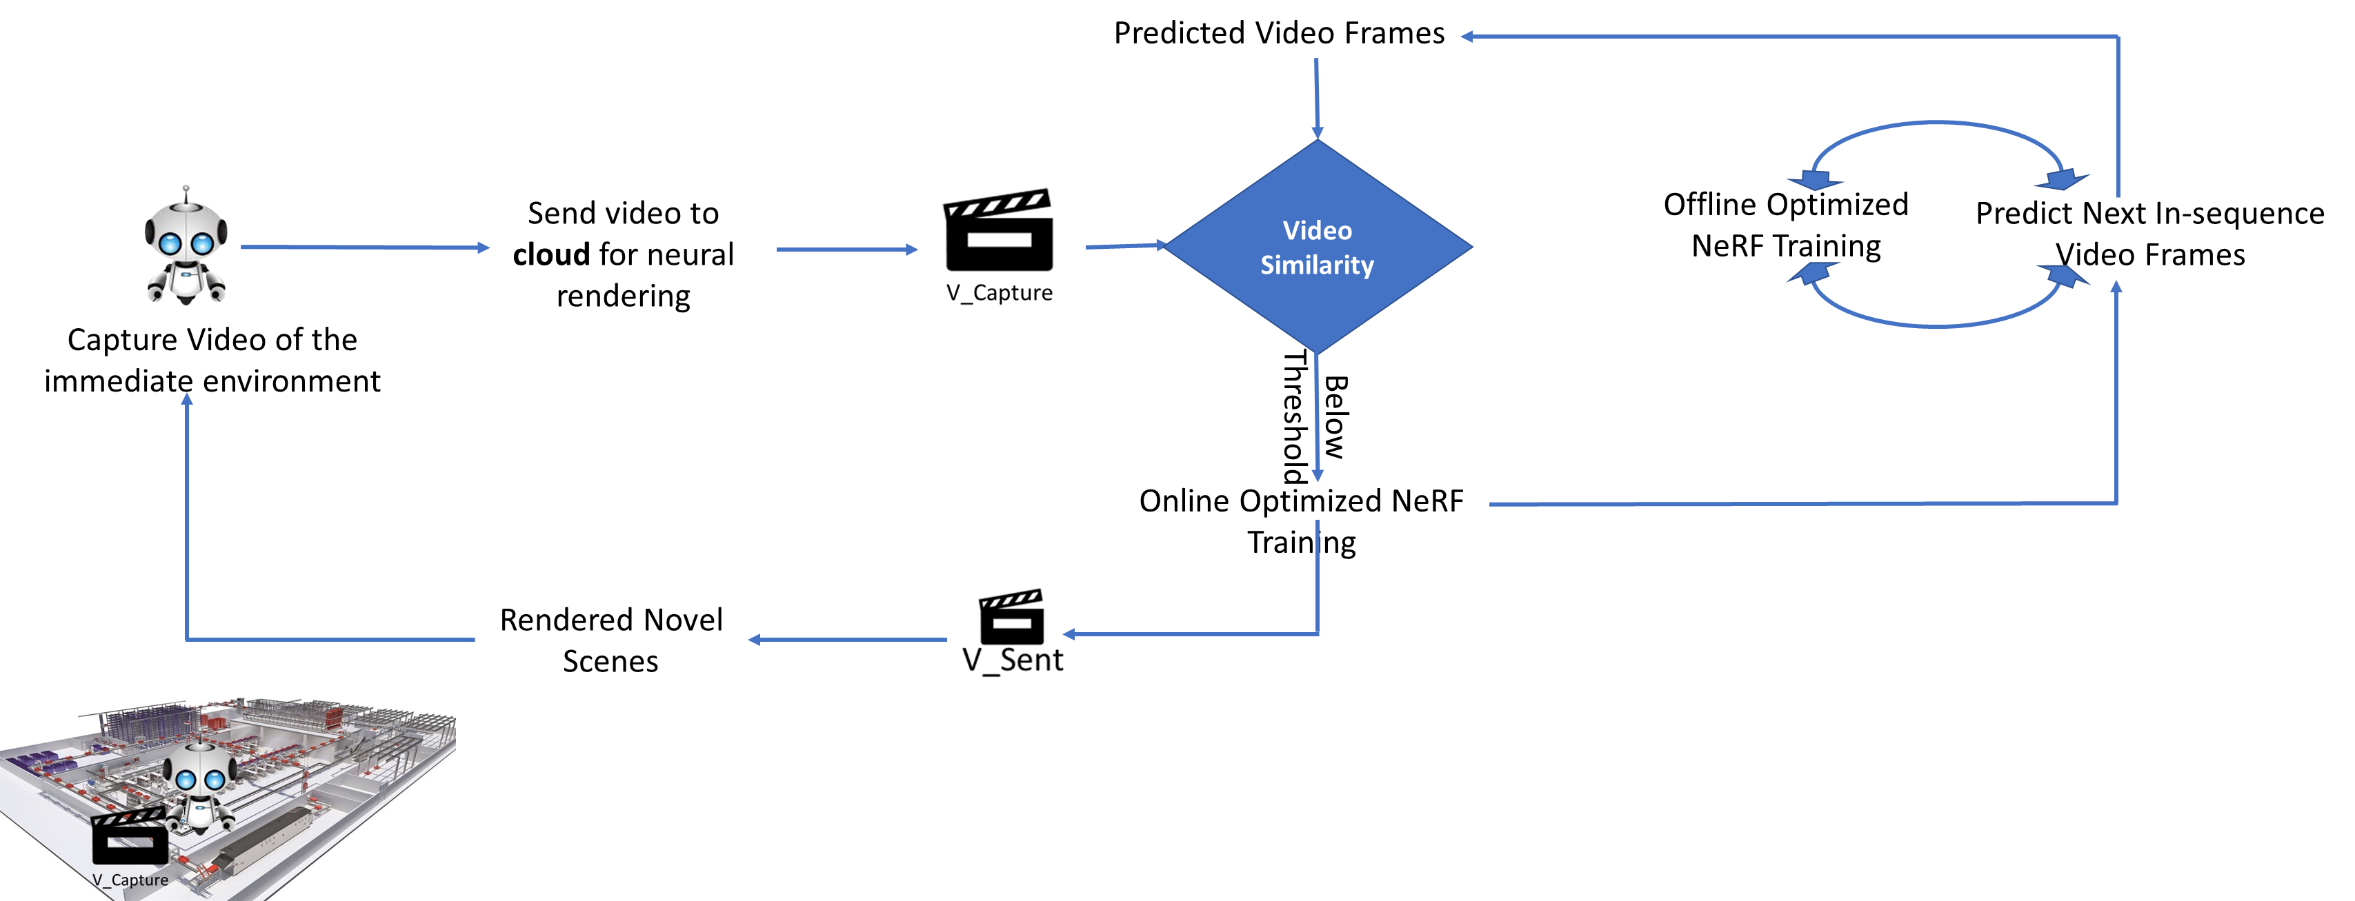
Proposed Architecture

Slide 6
Proposed Architecture
Predicted Video Frames
Pixel-wise similarity
Offline Optimized NeRF Training
Predict Next In-sequence Video Frames
Below Threshold
Online Optimized NeRF Training

Slide 7
Proposed Architecture
Predicted Video Frames
Pixel-wise similarity
Above Threshold
Offline Optimized NeRF Training
Predict Next In-sequence Video Frames

Slide 8
Proposed Architecture
Predicted Video Frames
Pixel-wise similarity
Above Threshold
Offline Optimized NeRF Training
Predict Next In-sequence Video Frames
Below Threshold
Online Optimized NeRF Training

Slide 9
Proposed Architecture
Predicted Video Frames
Pixel-wise similarity
Above Threshold
Offline Optimized NeRF Training
Predict Next In-sequence Video Frames
Below Threshold
Online Optimized NeRF Training

Slide 10
Proposed Architecture: Optimizations in NeRF
Elimination of Hierarchical Sampling
Design Space Exploration:
Effect of Learning Rate
Embedding Size
Number of Layers
Number of Neurons
Optimizers

Slide 11
Proposed Architecture
Predicted Video Frames
Pixel-wise similarity
Above Threshold
Offline Optimized NeRF Training
Predict Next In-sequence Video Frames
Below Threshold
Online Optimized NeRF Training

Slide 12
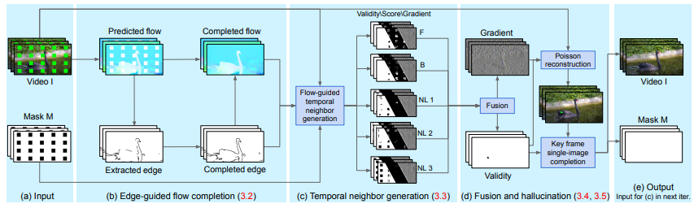
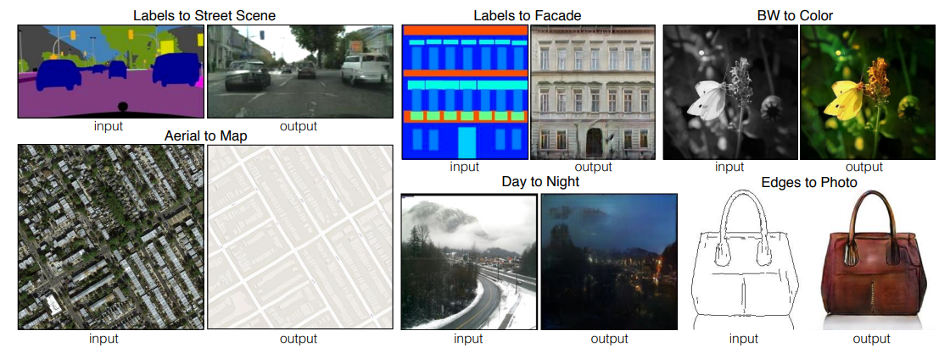
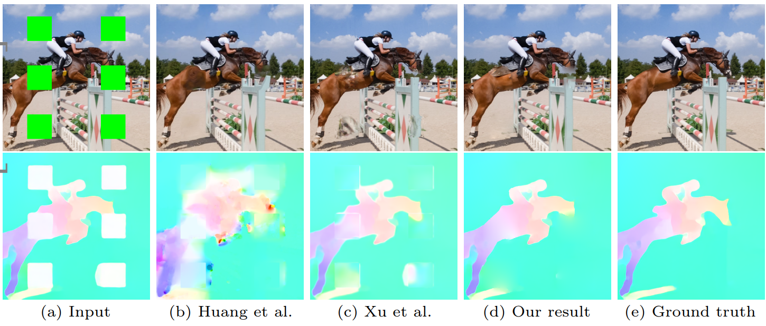
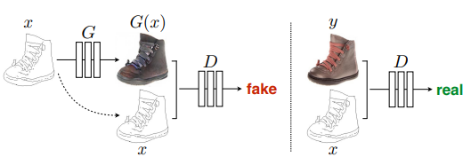
Proposed Architecture: Next Scene Sequence Prediction
Inspired from: Conditional Generative Adversarial Network Modelling
Obstacle Removal Algorithm
Phillip Isola, et. al., Image-to-Image Translation with Conditional Adversarial Networks
Chen Gao, et. al., Flow-edge Guided Video Completion

Slide 13
Proposed Architecture
Predicted Video Frames
Pixel-wise similarity
Above Threshold
Offline Optimized NeRF Training
Predict Next In-sequence Video Frames
Below Threshold
Online Optimized NeRF Training

Slide 14
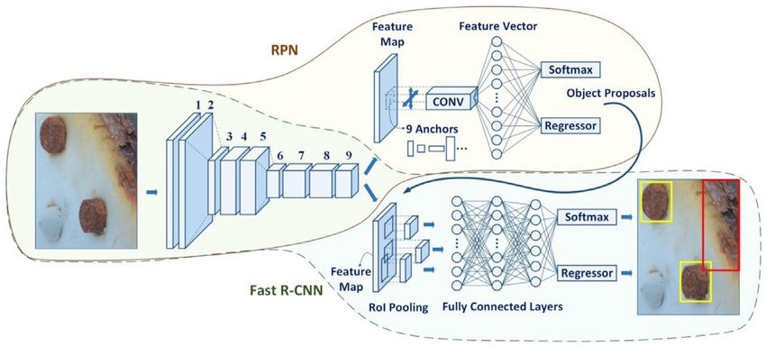
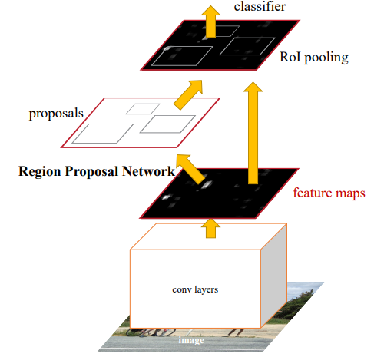
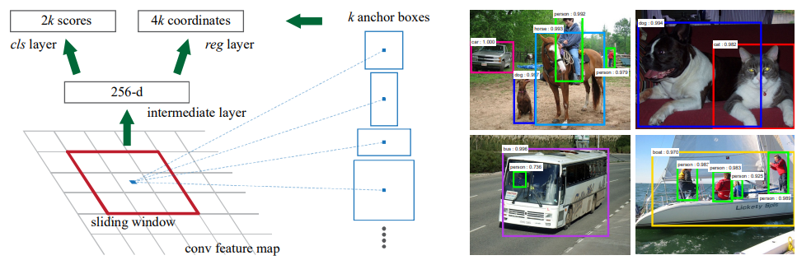
Proposed Architecture: Comparing Scene Similarity
Object Detection Algorithm:
Faster RCNN
Shaoqing Ren, et. al., Faster R-CNN: Towards Real-Time Object Detection with Region Proposal Networks

Slide 15
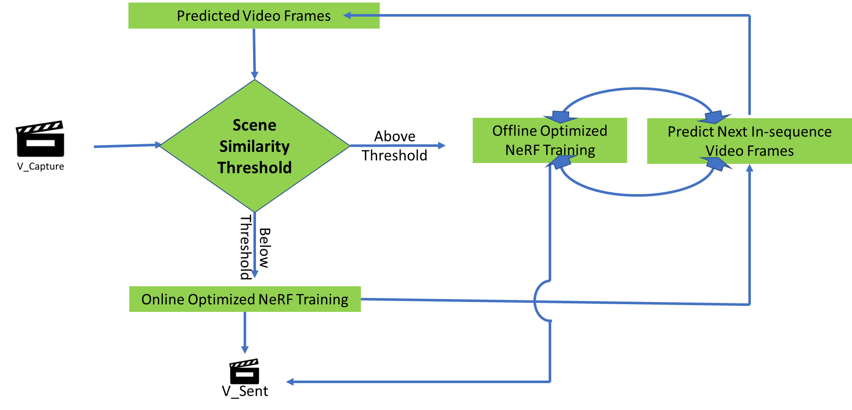
Key Contributions
Faster Neural Rendering through motion planning
Translating NeRF as a neural rendering engine to robotic locomotion
CHANGE

Slide 16
Evaluation Results

Slide 17
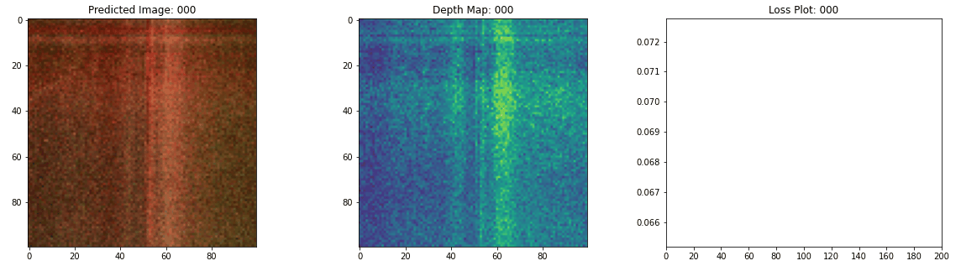
Evaluation Results: Optimizations in NeRF
Reproducing NeRF results

Slide 18
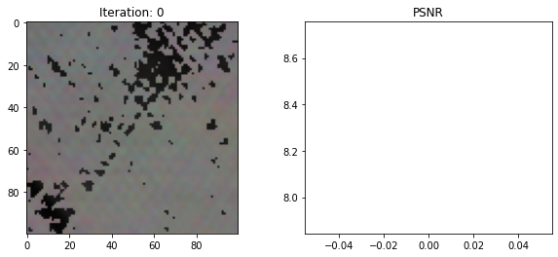
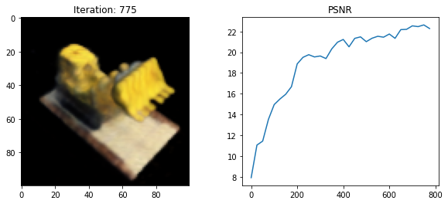
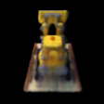
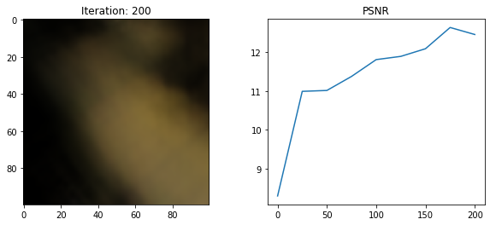
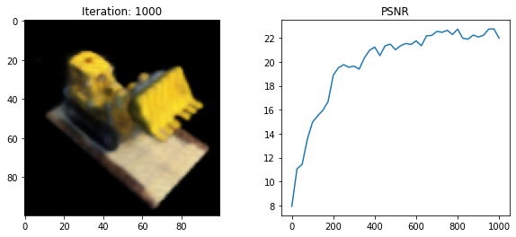
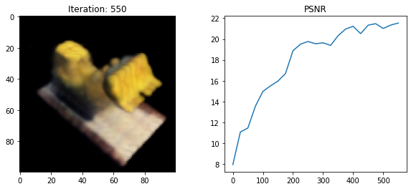
Evaluation Results: Optimizations in NeRF
NeRF without Hierarchical Sampling

Slide 19
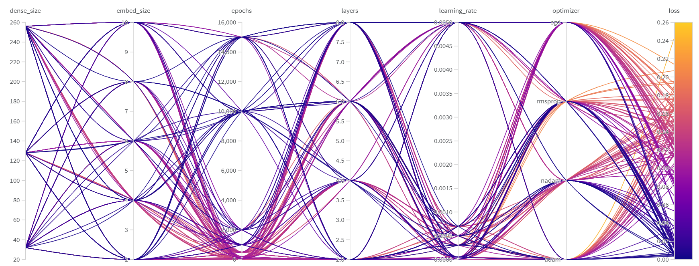
Evaluation Results: Optimizations in NeRF
https://wandb.ai/sweep/nerf/sweeps/tc7nxvwq?workspace=user-aray14

Slide 20
Evaluation Results: Optimizations in NeRF
Best results obtained for hyper-parameters:
Put in from the implementation.

Slide 21
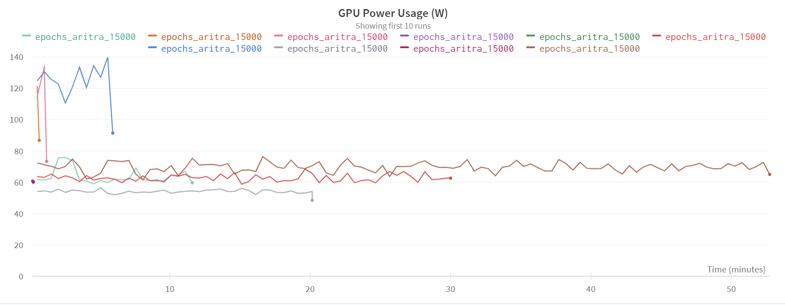
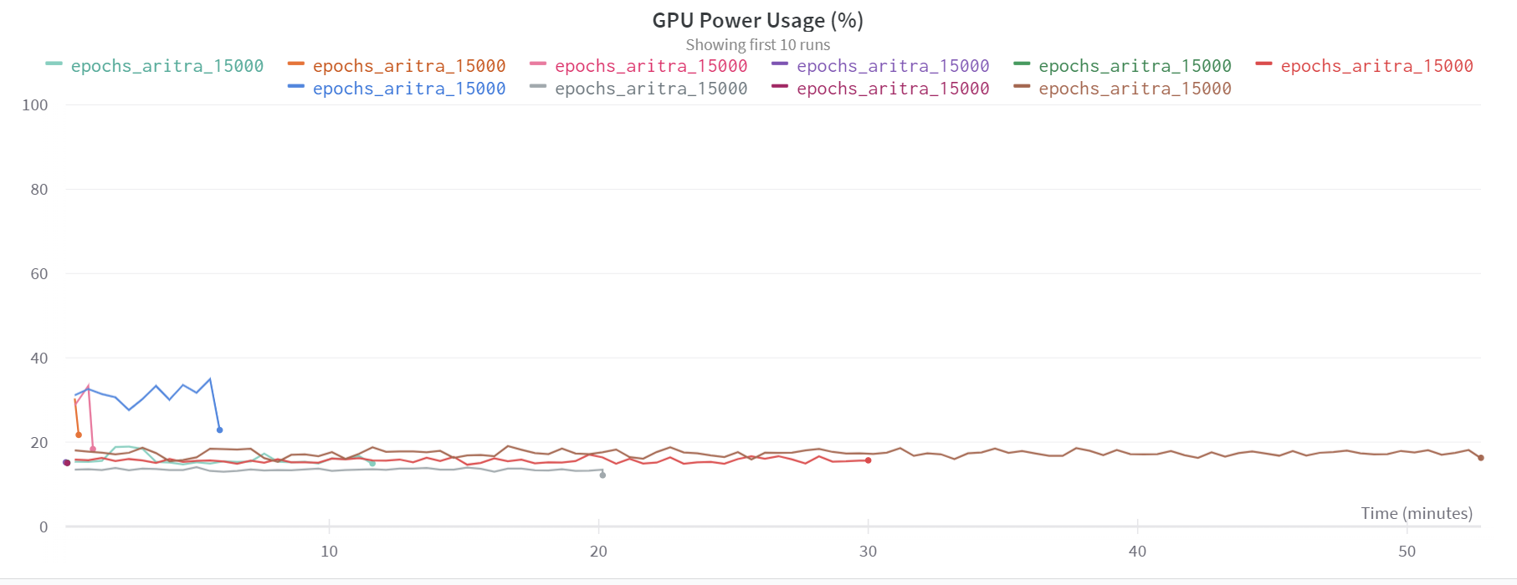
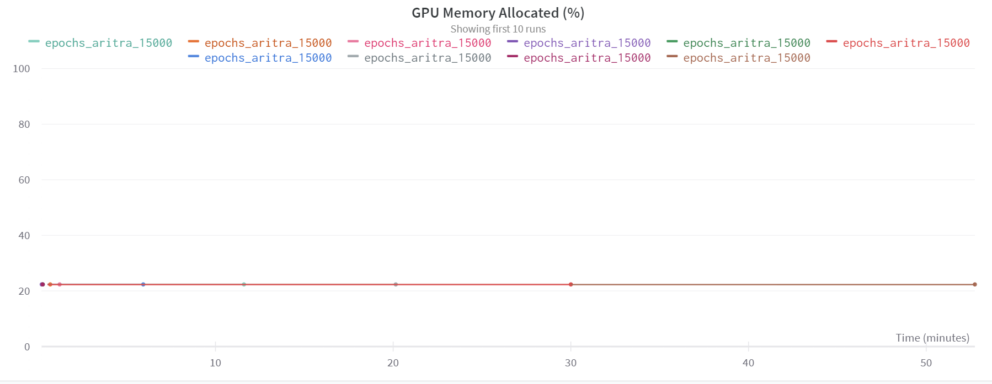
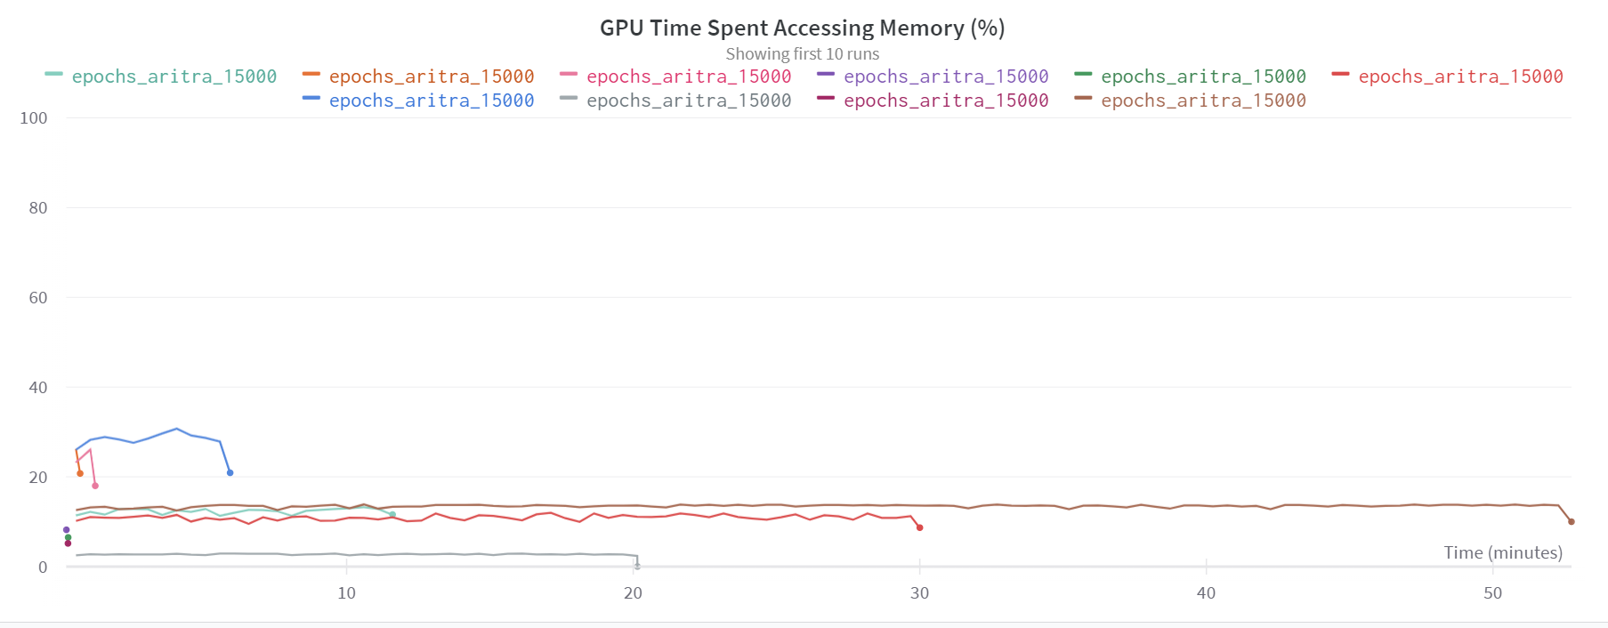
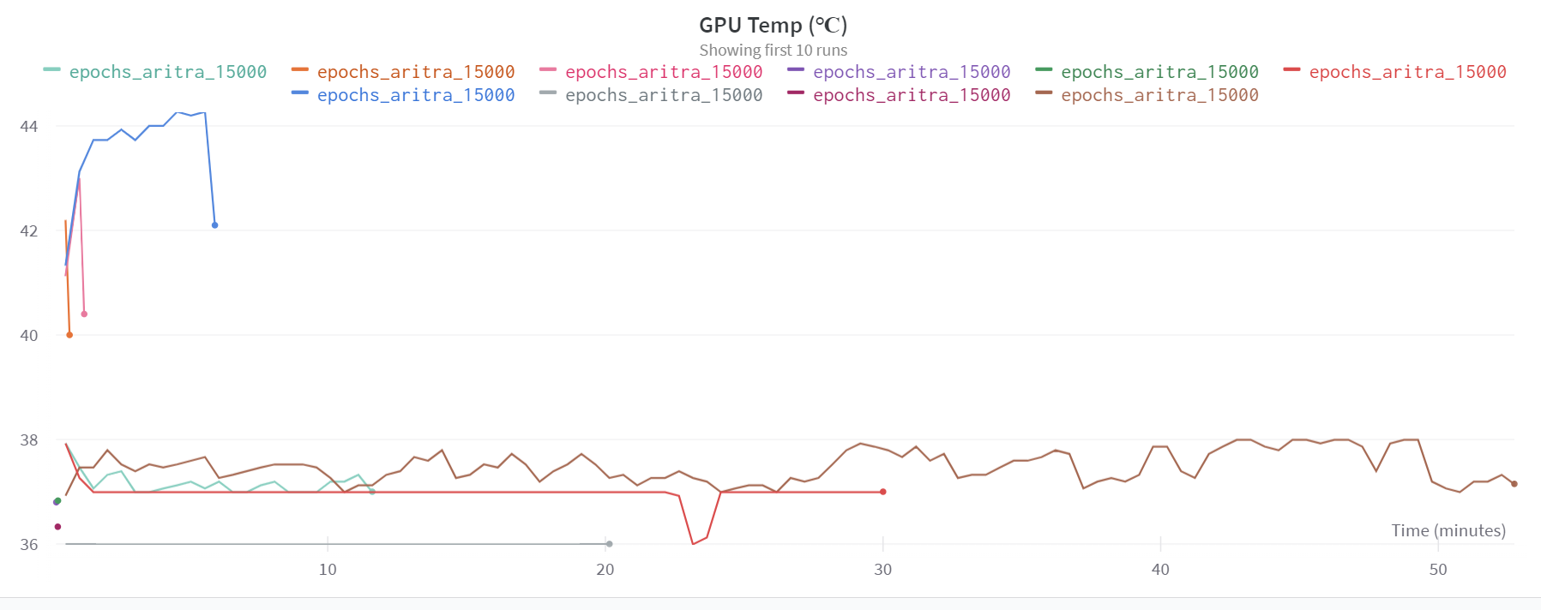
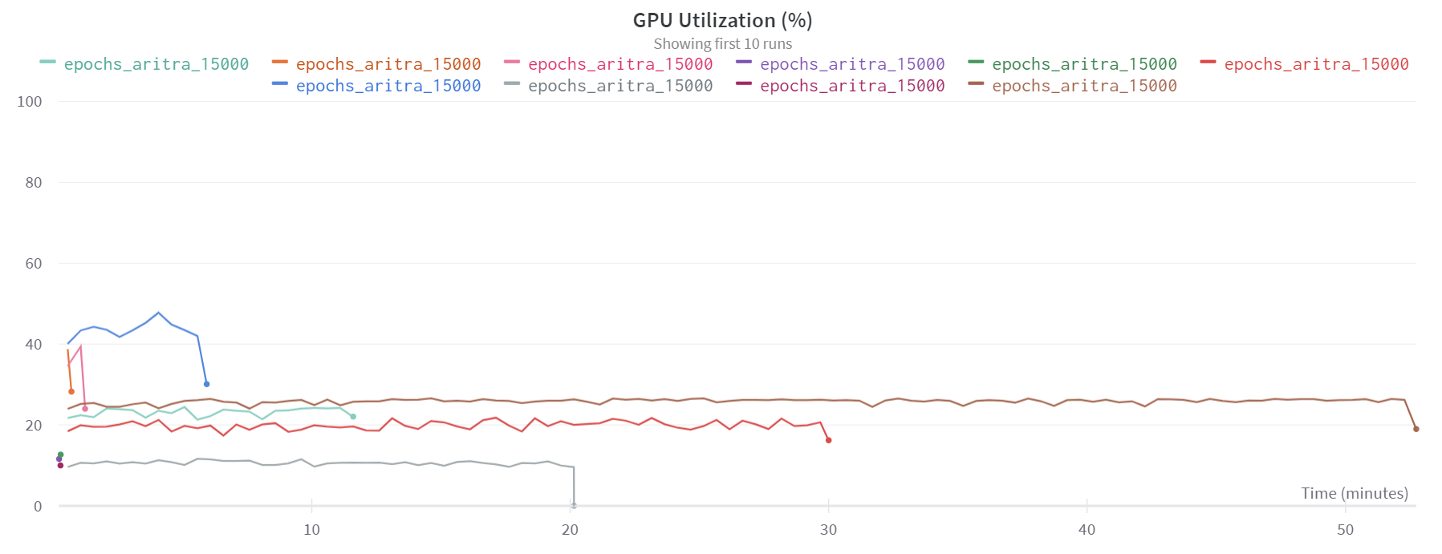
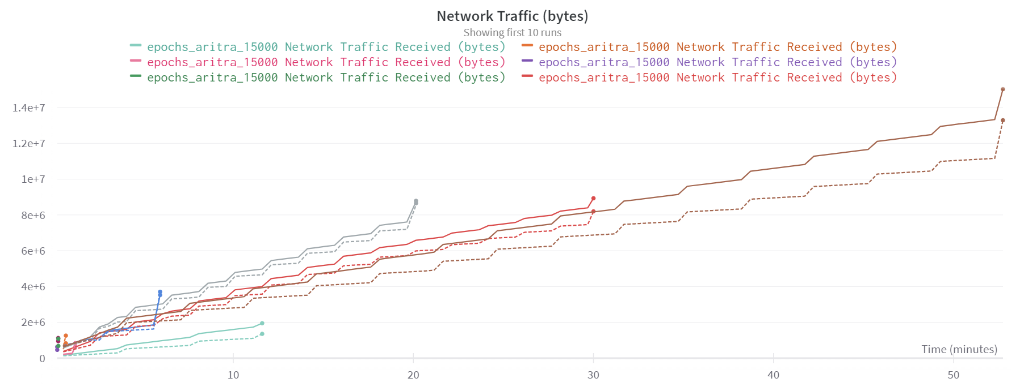
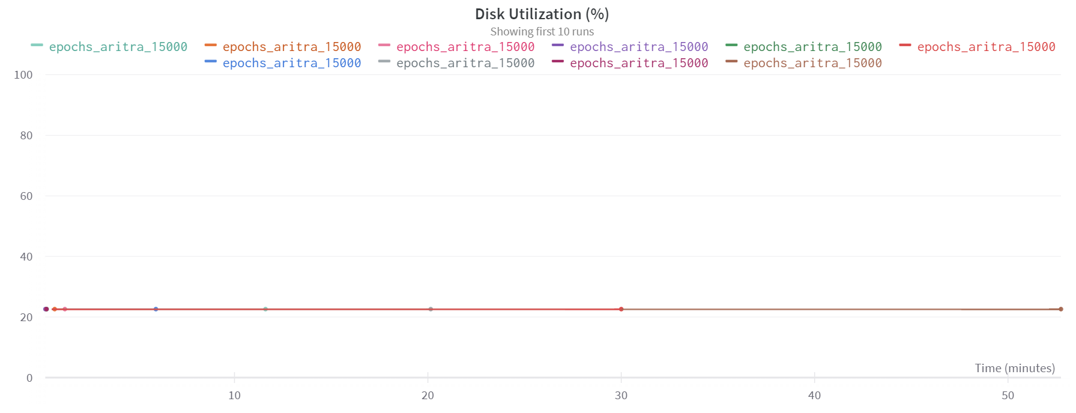
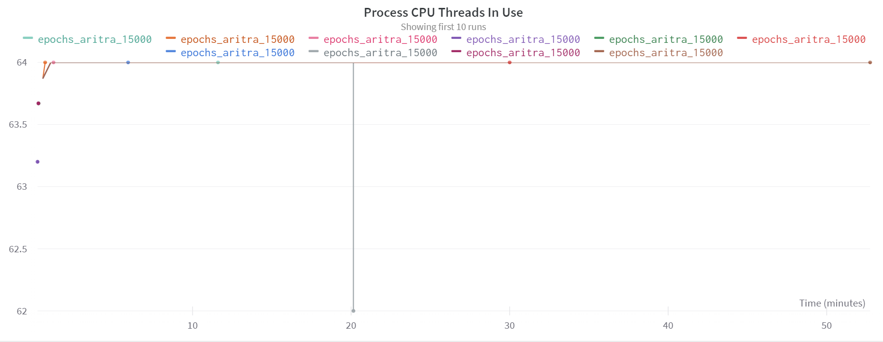
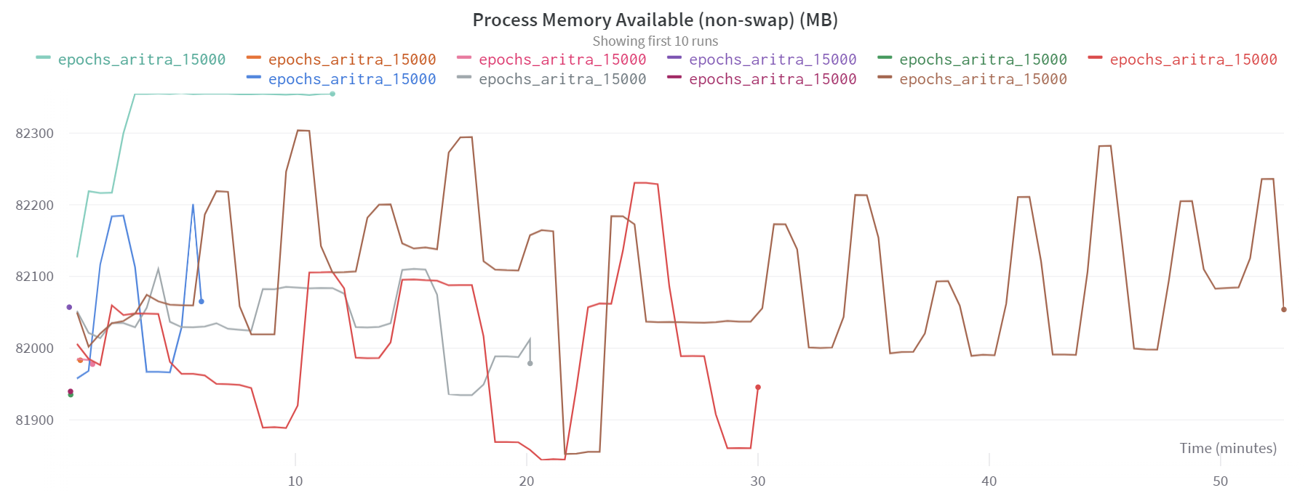
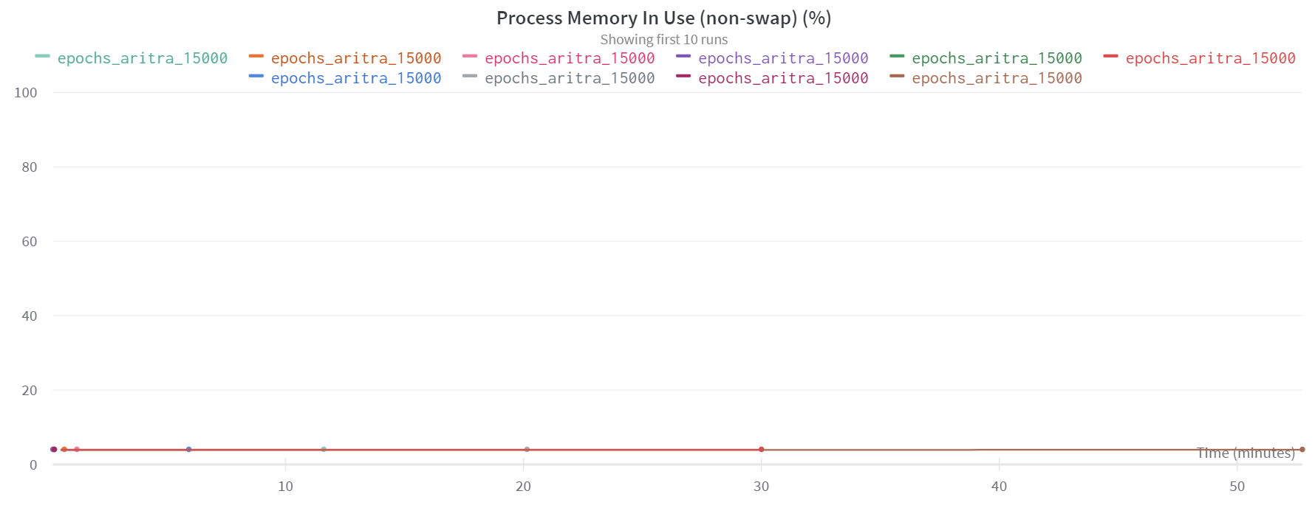
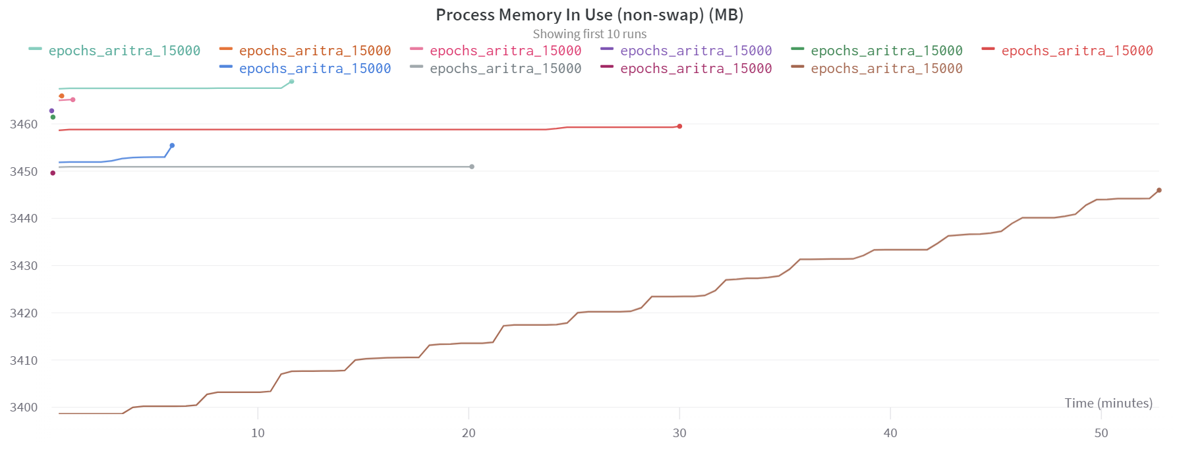

Slide 22
Evaluation Results: Optimizations in NeRF
Monitor several system parameters for NeRF Training:
GPU Power Usage
GPU Memory Allocated Percent
GPU Time Spent Accessing Memory Percent
GPU Temperature
GPU Utilization
Network Traffic
Disk Utilization
Memory Usage
https://wandb.ai/sweep/nerf/sweeps/tc7nxvwq?workspace=user-aray14

Slide 23

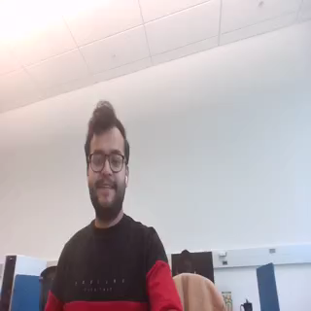


Evaluation Results: Next Scene Sequence Prediction
Frame 1
Pix2PixHD
Frame 60
Try more examples
Frame 159

Slide 24
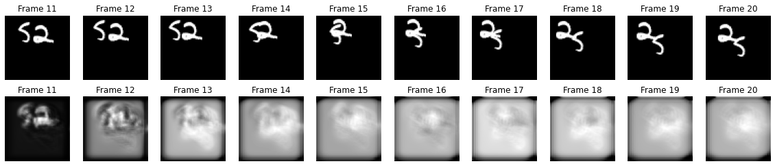
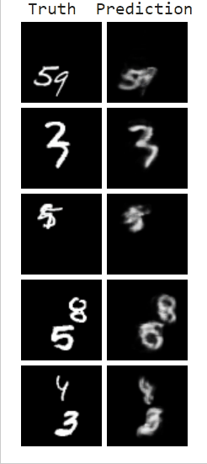
Next-Frame Video Prediction on Moving MNIST with Convolutional LSTMs.ipynb - Colaboratory (google.com)

Slide 25
Pix2PixHD Next Frame in Sequence Prediction(glitch-circle-white-720.mov).ipynb - Colaboratory (google.com)
Copy of Pix2PixHD Next Frame in Sequence Prediction(aritra.mp4).ipynb - Colaboratory (google.com)

Slide 26
Evaluation Results: Pixel-wise similarity
Show some results in tabular form…

Slide 27
Component-wise Related Works
Neural Rendering:
NeRF: Representing Scenes as Neural Radiance Fields for View Synthesis
Next In-sequence Video Prediction:
Generating Next Frame: Image-to-Image Translation with Conditional Adversarial Networks (Pix2PixHD)
Obstacle Removal: Flow-edge Guided Video Completion (FCGV)

Slide 28
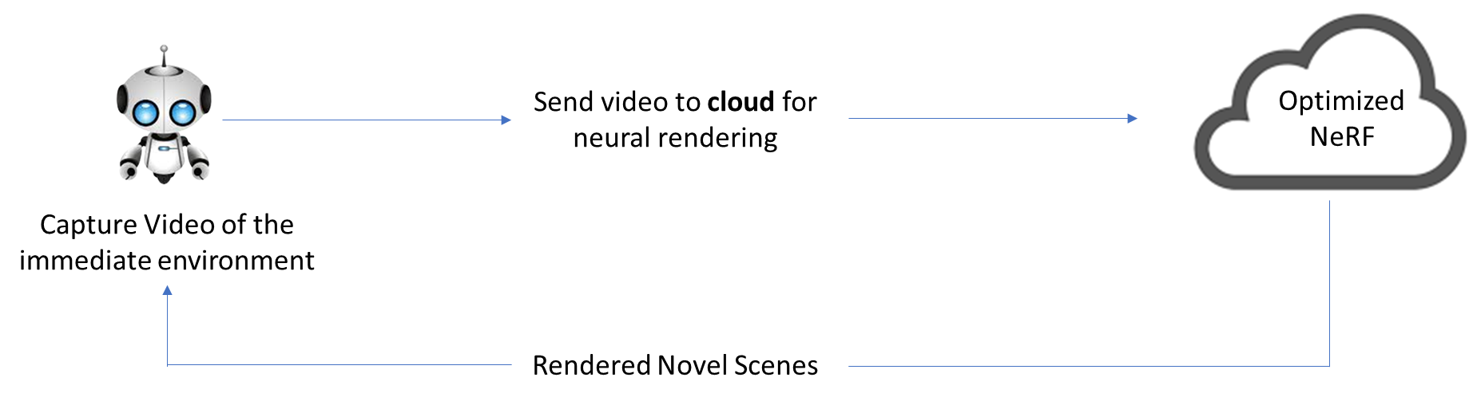

Research Implications
Similar Scenes
R1
R2
…
R5
Similar Scenes
This is beyond the scope of this project.

Slide 29
Future Work
Implement:
Explore further optimizations in NeRF
Explore other algorithms for Scene (Video) Prediction
Flow-edge Guided Video Completion: Obstacle Removal from Predicted Frames
Object Detection Algorithm: Scene Comparison
Integrate the modules together
Implementation Details:
Available on my GitHub profile: Aritra-14

Slide 30
Future Work
Predicted Video Frames
Pixel-wise similarity
Above Threshold
Offline Optimized NeRF Training
Predict Next In-sequence Video Frames
Below Threshold
Online Optimized NeRF Training

Slide 31
Thank You!
Notes:
Resources:
FGVC Code: https://colab.research.google.com/drive/17l8Jv1U0cM7tD9Kf910NEqi_N7naIUoY
Hyper-parameter optimizations: https://colab.research.google.com/drive/1fd2Hdnq-PNp9qr3UuXZMDK7rbmA4CZln
Wandb Visualizations: https://wandb.ai/sweep/nerf/sweeps/tc7nxvwq?workspace=user-aray14
Pix2PixHD: https://colab.research.google.com/drive/10MCX_VVXWjenpVTWOuYZE_m4ezx4uu4M#scrollTo=INVUtG-pt_F6

